Slide 1



SQL basic queries part 2
Sistem Basis Data
Rizka Wakhidatus Sholikah

Slide 2



Outline
Join
Order by
Special operators
www.its.ac.id
INSTITUT TEKNOLOGI SEPULUH NOPEMBER, Surabaya - Indonesia

Slide 3
JOIN
JOIN operators is used to combine data from multiple tables in meaningful ways
Usually the database designer design the database by decomposed the data into separate entities to fulfil the NF rules
By using JOIN the programmer reintegrates the data to satisfy the information requested by user
www.its.ac.id
INSTITUT TEKNOLOGI SEPULUH NOPEMBER, Surabaya - Indonesia

Slide 4
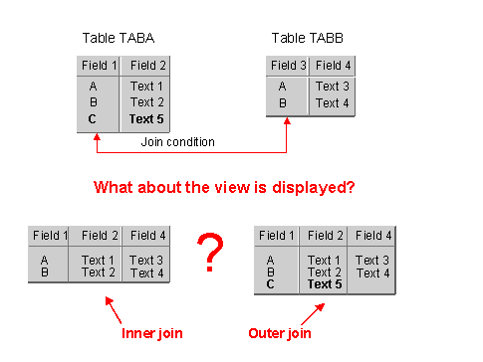
JOIN cont.
Inner joins Return only rows from the tables that match on a common value
Outer joins Return the same matched rows as the inner join, plus unmatched rows from one table or the other
www.its.ac.id
INSTITUT TEKNOLOGI SEPULUH NOPEMBER, Surabaya - Indonesia

Slide 5
Natural JOIN
Returns all rows with matching values in the matching columns and eliminates duplicate columns
This JOIN is used when the tables share one or more common attributes with common names
www.its.ac.id
INSTITUT TEKNOLOGI SEPULUH NOPEMBER, Surabaya - Indonesia

Slide 6
Natural JOIN
Syntax
SELECT column-list FROM table1 NATURAL JOIN table2
www.its.ac.id
INSTITUT TEKNOLOGI SEPULUH NOPEMBER, Surabaya - Indonesia

Slide 7
Natural JOIN
What natural join do?
Determines the common attributes by looking for the attributes with identical name and compatible data type
Select only the rows with common values in the common attributes
If there are no common attributes, returns the relational product of the two tables
www.its.ac.id
INSTITUT TEKNOLOGI SEPULUH NOPEMBER, Surabaya - Indonesia

Slide 8
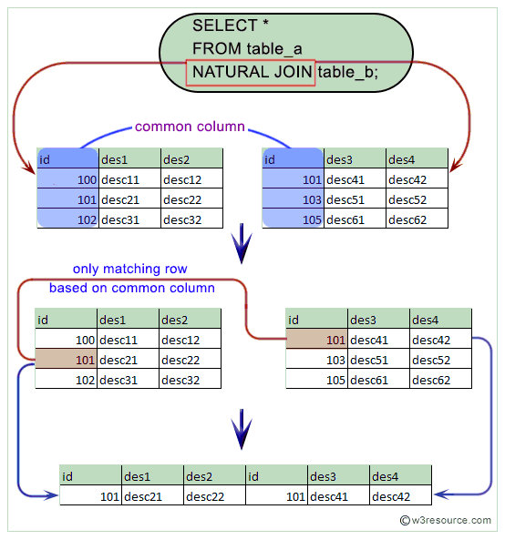
Natural JOIN
Example
www.its.ac.id
INSTITUT TEKNOLOGI SEPULUH NOPEMBER, Surabaya - Indonesia
Notes:
Source: https://www.w3resource.com/mysql/advance-query-in-mysql/mysql-natural-join.php

Slide 9
JOIN USING syntax
Second way to express the join is through the USING keyword
The query returns only the rows with matching values in the column indicated in the USING clause (the column must be exist in both tables)
Syntax
SELECT column-list FROM table1 JOIN table2 USING (common-column)
SELECT * FROM table_a JOIN table_b USING (id)
www.its.ac.id
INSTITUT TEKNOLOGI SEPULUH NOPEMBER, Surabaya - Indonesia

Slide 10
JOIN ON syntax
JOIN ON operator is used to express join when there is no common attribute names
The query returns only the rows that meet the indicated join condition
The join condition typically includes an equality comparison expression of two columns
The columns may or may not share the same name, but obviously they must have comparable data types
www.its.ac.id
INSTITUT TEKNOLOGI SEPULUH NOPEMBER, Surabaya - Indonesia

Slide 11
JOIN ON syntax
Syntax
SELECT column-list FROM table1 JOIN table2 ON join-condition
SELECT * FROM table_a JOIN table_b ON table_a.id = table_b.id
www.its.ac.id
INSTITUT TEKNOLOGI SEPULUH NOPEMBER, Surabaya - Indonesia

Slide 12
Outer joins
An outer join returns not only the rows matching the join condition, but it also returns the rows with unmatched values
There are three types of outer join:
Left outer join
Right outer join
Full outer join
The first table that named in the FROM clause will be the left side
The second table named will be the right side
If there are more than two tables, the result of joining the first two table become the left side, and the third table become the right side
www.its.ac.id
INSTITUT TEKNOLOGI SEPULUH NOPEMBER, Surabaya - Indonesia

Slide 13
Left outer joins
The left outer join returns not only the rows matching the join condition, but also returns the rows in the left table with unmatched value in the right table
Syntax
SELECT column-list FROM table1 LEFT [OUTER] JOIN table2 ON join-condition
www.its.ac.id
INSTITUT TEKNOLOGI SEPULUH NOPEMBER, Surabaya - Indonesia

Slide 14
Right outer joins
The right outer join returns not only the rows matching the condition but it also returns the rows in the right table with unmatched values in the left table
Syntax
SELECT column-list FROM table1 RIGHT [OUTER] JOIN table2 ON join-condition
www.its.ac.id
INSTITUT TEKNOLOGI SEPULUH NOPEMBER, Surabaya - Indonesia

Slide 15
Full outer joins
The full outer join returns not only the rows that matching the join condition, but also all of the rows with unmatched values in the table on either side
Syntax
SELECT column-list FROM table1 FULL [OUTER] JOIN table2 ON join-condition
www.its.ac.id
INSTITUT TEKNOLOGI SEPULUH NOPEMBER, Surabaya - Indonesia

Slide 16

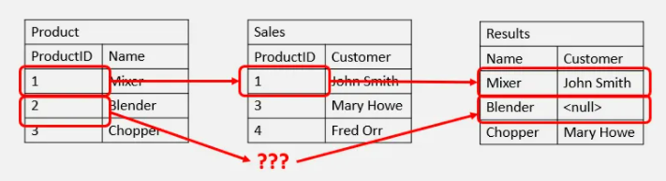

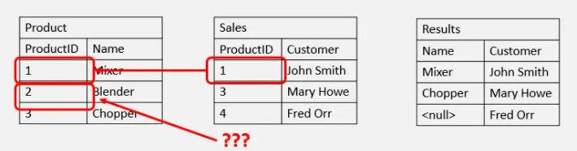
Left outer join vs Right outer join
www.its.ac.id
INSTITUT TEKNOLOGI SEPULUH NOPEMBER, Surabaya - Indonesia
Notes:
Source: https://www.essentialsql.com/what-is-the-difference-between-a-right-and-left-outer-join/

Slide 17
Cross joins
Cross join performs a relational product of two tables
The result is the number of rows in the first table multiplied by the number of rows in the second table
Syntax
SELECT column-list FROM table1 CROSS JOIN table2
www.its.ac.id
INSTITUT TEKNOLOGI SEPULUH NOPEMBER, Surabaya - Indonesia

Slide 18
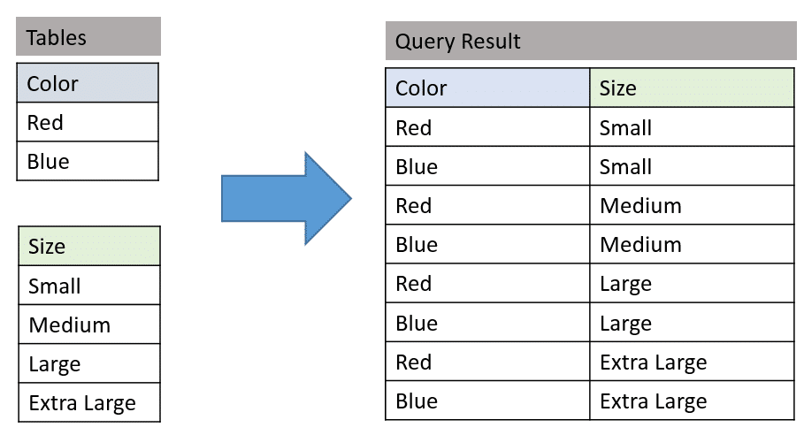
Cross joins
www.its.ac.id
INSTITUT TEKNOLOGI SEPULUH NOPEMBER, Surabaya - Indonesia
Notes:
Source: https://www.essentialsql.com/sql-cross-join/

Slide 19
Order by
Order by clause is useful when the listing order is important
The default order is ascending
Syntax
SELECT columnlist FROM tablelist [ORDER BY columnlist [ASC | DESC] ]
www.its.ac.id
INSTITUT TEKNOLOGI SEPULUH NOPEMBER, Surabaya - Indonesia

Slide 20
Cascading order sequence
A nested ordering sequence for a set of rows
For example
SELECT EMP_LNAME, EMP_FNAME, EMP_INITIAL, EMP_AREACODE, EMP_PHONE
FROM EMPLOYEE
ORDER BY EMP_LNAME, EMP_FNAME, EMP_INITIAL;
The three stages order from the above example:
1. ORDER BY last name. 2. Within matching last names, ORDER BY first name. 3. Within matching first and last names, ORDER BY middle initial
www.its.ac.id
INSTITUT TEKNOLOGI SEPULUH NOPEMBER, Surabaya - Indonesia

Slide 21
Special operators
ANSI-standard SQL allows the use of special operators in conjunction with the WHERE clause
BETWEEN Used to check whether an attribute value is within a range
IN Used to check whether an attribute value matches any value within a value list
LIKE Used to check whether an attribute value matches a given string pattern
IS NULL Used to check whether an attribute value is null
www.its.ac.id
INSTITUT TEKNOLOGI SEPULUH NOPEMBER, Surabaya - Indonesia

Slide 22
BETWEEN operators
Example
SELECT *
FROM PRODUCT
WHERE P_PRICE BETWEEN 50.00 AND 100.00;
www.its.ac.id
INSTITUT TEKNOLOGI SEPULUH NOPEMBER, Surabaya - Indonesia

Slide 23
IN operators
Example
SELECT *
FROM PRODUCT
WHERE V_CODE IN (21344, 24288);
www.its.ac.id
INSTITUT TEKNOLOGI SEPULUH NOPEMBER, Surabaya - Indonesia

Slide 24
LIKE operators
Used to find patterns within string attributes
% and _ are wildcard characters to make matches when the entire string is not known
% means any and all following or preceding characters are eligible
Example: ‘J%’ includes ‘John’, ‘James’, ‘J-123’
_ means any one character may be substituted for the underscore
Example: ‘_o_es’ includes ‘Jones’, ‘Cokes’
www.its.ac.id
INSTITUT TEKNOLOGI SEPULUH NOPEMBER, Surabaya - Indonesia

Slide 25
LIKE operators
Example
SELECT V_NAME, V_CONTACT, V_AREACODE, V_PHONE
FROM VENDOR
WHERE V_CONTACT LIKE 'Smith%';
www.its.ac.id
INSTITUT TEKNOLOGI SEPULUH NOPEMBER, Surabaya - Indonesia

Slide 26
IS NULL operators
To check for null attributes
Example
SELECT P_CODE, P_DESCRIPT, V_CODE
FROM PRODUCT
WHERE V_CODE IS NULL;
www.its.ac.id
INSTITUT TEKNOLOGI SEPULUH NOPEMBER, Surabaya - Indonesia

Slide 27
Thank you

